Slide 1
Public Lands Rule and the CCS
July 31, 2024
SEP
Kathleen Steele, Program Manager
Cheyenne Acevedo, NDOW
Casey Adkins, NDF
Skyler Monaghan, NDA
Sarah Hale, NDSL

Slide 2
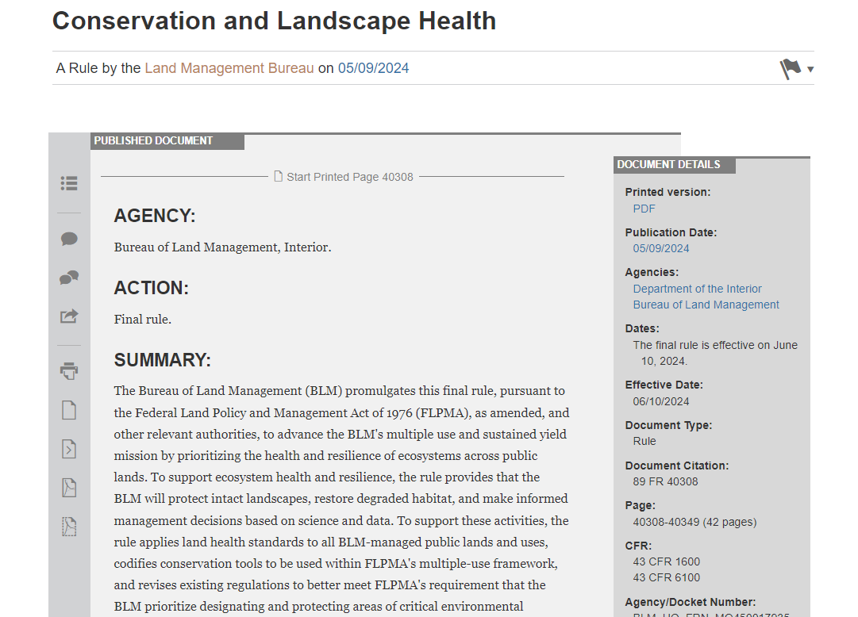
Public Lands Rule
  The Public Lands Rule delivers on the Bureau’s promise to sustain the health, diversity, and productivity of public lands for present and future generations.

Slide 3
New Opportunities
Conservation is now a commodity
Open to:
  Public/Permittees
  Mitigation/Conservation Banks
  Conservation Districts
  State Wildlife Agencies
States explicitly that restoration or mitigation leases would only be authorized if they do not conflict with existing authorizations
Leases do not override valid existing rights, privileges or preclude other, subsequent authorizations compatible with the lease

Slide 4
Further Work is Needed
Implementation Guidance for BLM use still being created
Still in conversations with our Science Team to figure out how to implement with the CCS
  Time Frame Concerns
  Durability
  Land Health Standard Requirements
    Land Health Standards at minimum must be met before a lease can be authorized

Slide 5
Criteria for Land Transactions to Benefit Conservation
Federal Land Transaction Facilitation Act (FLTFA)
  Created in 2000, reauthorized in 2018 for perpetuity
  The BLM can purchase or exchange land for accessibility to other public lands and consolidation of checkerboarded areas
  Article mentioned just emphasizing that land can also be purchased by the federal government for conservation purposes

Slide 6
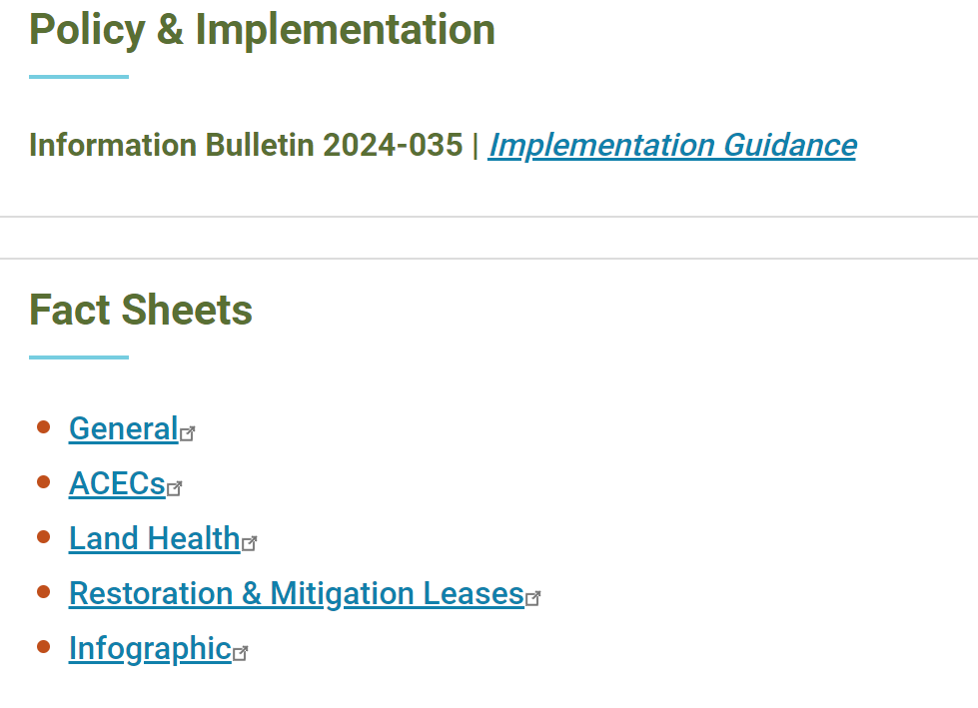
More Information
Actual Rule:
  https://www.ecfr.gov/current/title-43/subtitle-B/chapter-II/subchapter-F/part-6100
  https://www.ecfr.gov/current/title-43/subtitle-B/chapter-II/subchapter-F/part-1600
  Preamble/summary: https://www.federalregister.gov/documents/2024/05/09/2024-08821/conservation-and-landscape-health
Website:
  https://www.blm.gov/public-lands-rule

